Slide 1



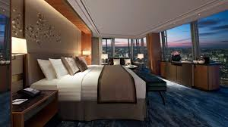
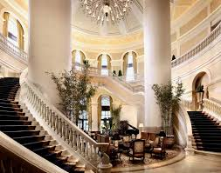
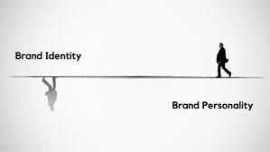
Exploring the Effects of Brand Personality on Brand Trust, Affect, and Loyalty in the Luxury Hotel Context
MiRan Kim, Laee Choi, & Bonnie Knutson

Slide 2
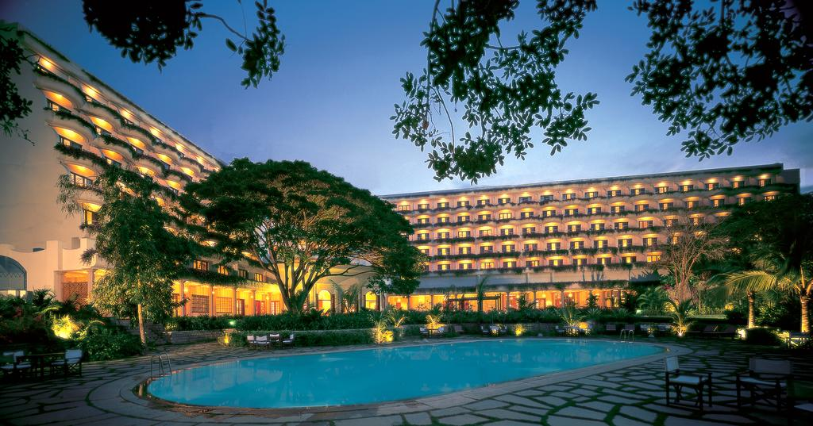

The Global Luxury Hotel Market
  The emergence of a new market segment (Chadha and Husband, 2006)
  Valued at USD 83.10 billion in 2017 and is anticipated to increase to 222 billion in 2024 (Luxury Hotel Market, 2018; Reuters, 2019).
  Globalization and cultural convergence (Chadha and Husband, 2006)
  A consistent rise in the number of wealthy consumers (Okonkwo, 2009)
Notes:
The consumption of luxury brands has been influenced by a numerous macro-environmental trends, such as globalization and cultural convergence (Chadha and Husband, 2006); the emergence of new market segments (Okonkwo, 2009); a consistent rise in the number of wealthy consumers, and the increasing attention that luxury brands receive from the media (Mandel et al., 2006).
-The global luxury hotel market size was valued at USD 83.10 billion in 2017 and is anticipated to expand at a CAGR of 4.3% over the forecast period (Luxury Hotel Market, 2018).
-In the U.S., revenues in the luxury hotel segment have expanded significantly over the last few years, rising from $1.2 trillion in 2009 to $1.6 trillion in 2011. For example, Four Seasons prioritizes gaining a better understanding of their guests through developing an ongoing two-way conversation with them. More importantly, it focuses on enabling guests to fully engage with the brand experience.
It recognizes that luxury hotel guests are looking for intrinsic value and a deeper relationship with the brands (Four Seasons Luxury Trend Report, 2012). Because the luxury hotel segment is an important growing market, the study of brand personality in this sector will be particularly timely for hotel marketers.

Slide 3
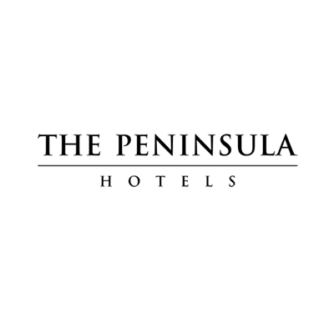
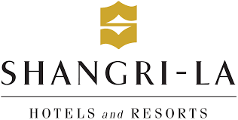
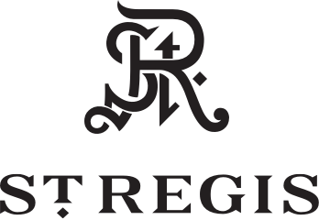
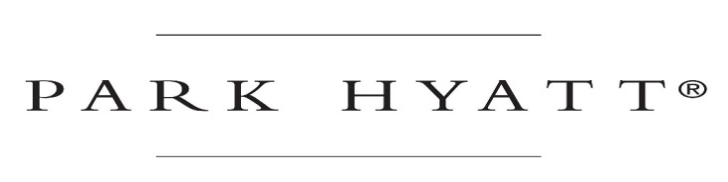


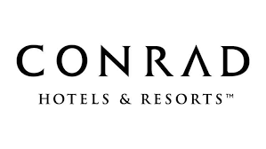


Top Five Global Luxury Hotel Companies
The top five companies (Marriott Hilton, Hyatt Hotels, Four Seasons, and Shangri-La ) make up more than 25% market share of the luxury hotels segment.

Slide 4


Brand Personality
Brand Personality is the set of human characteristics associated with a brand (Aaker, 1997).
Customers are more likely to choose a specific brand that they like and that is consistent with their personalities (Health and Scott, 1998).
Brand personality relates to consumer trust and emotions (Kim and Kim, 2004) and strong and differentiated brands are intangible assets that enhance a firm’s financial value and brand equity (O’Neill & Mattila, 2006).
Notes:
Brand personality relates to consumer trust and emotions that are established in a consumer’s mind (Kim and Kim 2004). Since Aaker (1997) first introduced the concept of brand personality, a significant amount of research has been conducted in various industry settings. A strong and differentiated brand is an intangible asset that enhances a firm’s financial value and brand equity (O’Neill and Mattila, 2006). Because brands create an identity and personality with a set of promises to customers, customers are more likely to choose a specific brand that they like and that is consistent with their personalities (Heath and Scott, 1998).

Slide 5
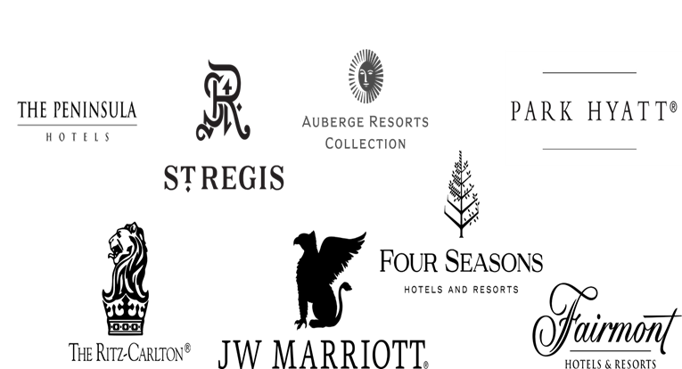
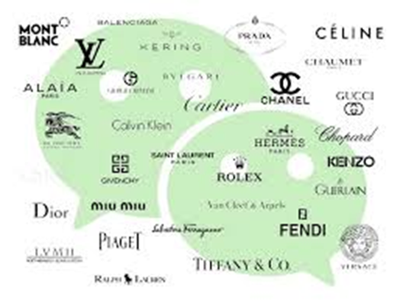
Luxury Hotel Brand Personality
Customers feel better about themselves by purchasing luxury brands as they feel a sense of pride, accomplishment, and fulfillment in owning products and services of luxury brands (Keller, 2009).
In the luxury hotel market, brand personality can be a critical driver to develop strong relationships with customers and loyalty with one brand over another (Siguaw et al., 1999).
As an important emerging market, the study of brand-personality functions in this luxury hotel segment will be timely for hotel marketers.
Notes:
Keller (2009) suggested that luxury brands make consumers feel better about themselves; i.e., consumers feel a sense of pride, accomplishment, and fulfillment in owning objects bearing the labels of luxury brands.
In the hospitality industry, brand personality is proposed to be a critical driver that develops customer preference and strong relationship with one brand over another (Siguaw et al., 1999).
In the hotel industry, brand personality is proposed to be a critical driver that develops customer preference and strong relationship with one brand over another because functional characteristics of hotel products are difficult to be differentiated (Siguaw et al., 1999).
Brands create an identity and personality with a set of promises to customers and customers are likely to choose a certain brand that they like, and they feel that the brand they select to be consistent with their personalities (Heath & Scott, 1998).
Furthermore how does branding play a key role in this? In the hotel industry, a brands personality serves as the focal point for developing loyalty amongst customers and enhancing reputation. More importantly, it can help with relational ties, consisting of social benefits, trust and loyalty (Sung, Kim, & Jung, 2009). However, there is little empirical research that has investigated the structure of luxury hotel brand-personality dimensions and scales.

Slide 6

Study Objectives
Based on Aaker’s (1997) Brand Personality Dimensions, this study is to:
  Examine the impact of brand personality dimensions-sincerity, excitement, competence, and sophistication-on brand trust, affect, and loyalty in the luxury hotel context.
  Explore the relative impact of each brand personality dimension on brand trust and affect through dominance analysis.
  Considering that little research has been conducted on the role of brand personality on actual consumer behaviors in the hospitality industry, this study can contribute significant insights into the hospitality literature and practices.
Notes:
the scale has recently been criticized on a generalization (e.g., Austin et al., 2003; Geuens et al., 2009; Siguaw et al., 1999). Therefore, to obtain clearer insight into the guest-brand relationship in the hospitality industry, the goal of this study is to examine the impact of brand personality dimensions-sincerity, excitement, competence, sophistication brand trust and affect - on loyalty in the luxury hotel context. More precisely, this study will explore the relative impact of each brand personality dimension on trust and affect through dominance analysis. Figure 1 depicts the research model to achieve the purposes of this study.
Based on Aaker’s (1997) five brand personality dimensions (sincerity, excitement, competence, sophistication, and ruggedness), the purpose of this study is 1) to examine two new dimensions of brand personality (exclusivity, innovativeness), and 2) to explore the impact of brand personality dimensions (exclusivity, innovativeness, sincerity, excitement, competence, and sophistication) n the luxury hotel context.

Slide 7
Brand Personality
The Proposed Model
Sincerity
H1
Brand Trust
H2
H9
H3
Excitement
Brand Loyalty
H4
H5
H10
Competence
Brand Affect
H6
H7
Sophistication
H8

Slide 8
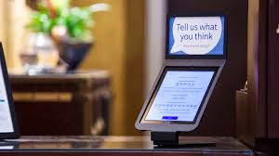
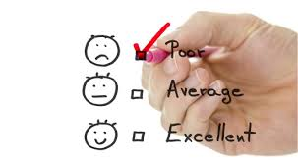

  Methodology
A pilot study (n=30)
A self-administered on-line survey using Qualtrics
Luxury hotel guests in the U.S.
Conducted the survey December 2018
A five-point Likert scale (1=not at all to 5: exactly, 1=strongly disagree to 5=strongly agree)
Used SPSS 22.0 software for descriptive statistics and multiple regression. Conducted dominance analysis

Slide 9

Respondents’ Profiles
Gender | Female (80%) vs. Male (20 %)
Average age | 19-29 years old: 50% 50-59 years old:46% 40-49 years old:4%
Ethnicity | Caucasians: 96% Others (e.g., : African American, Hispanic): 4%
Education | Four-year degree: 64% Post graduate degree:24% Others (e.g., college, Associate’s degree, no degree): 12%
Income | Prefer not to respond: 40% $100,000-$199,000: 20% $500,000 or more: 16% $300,000-$399,000: 12% $200,000-$299,000: 8%

Slide 10
Brand Personality
Model Testing
Sincerity
.498*
Brand Trust
.679***
.579***
R²=.670
.520*
Excitement
Brand Loyalty
.727***
R²=.556
.909***
Competence
Brand Affect
.554***
.951***
.540*
R²=.649
Sophistication
.535**
Notes:
Behavioral Intention of Social media

Slide 11
Dominance Analysis:
Relative importance of brand personality dimensions on brand trust and affect
Notes:
In addition to the baseline model testing, we also conducted dominance analysis, which permits the direct comparison of predictors in a research model (Budescu, 1993). This analysis tests the relative importance of each dimension of brand personality on brand trust and brand affect. As shown in Figure 2, “competence” exerts the greatest impact on both trust and affect followed by “sincerity.” “competence” (51%) is found to be the dominating dimension to increase brand trust as the functional aspects, reliable and intelligent, are closely related to cognitive responses, trust. However, “sincerity” (32%) has a similar impact on brand affect to “competence” (34%) as brand affect is more influenced by emotional aspects, such as honest and cheerful. Similarly, the influence of “excitement” is found to be greater on affect than on trust.

Slide 12
Dominance Analysis:
Relative importance of brand personality dimensions on trust and affect

Slide 13
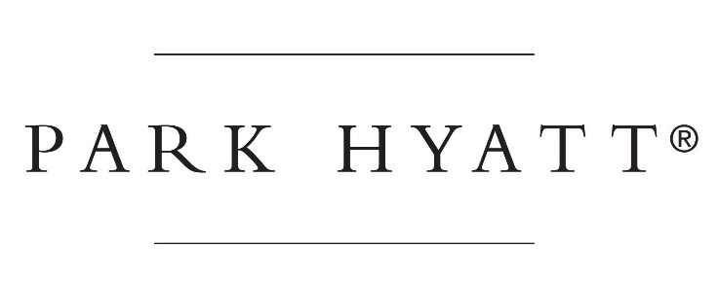
Implications & Discussion
The findings of this study can make valuable contributions to brand personality literature and brand managers who may apply the findings to develop more competitive brand strategies and create better brand value
In particular, this study provides a deeper understanding of the customer-brand relationship in the hospitality business context.

Slide 14



Implications & Future Study
Further, the brand personality dimensions developed by Aaker (1997) (i.e., sincerity, excitement, competence, and sophistication) were shown to be a reliable and valid framework in our study.
To provide a deeper and more precise understanding of brand personality, future research can add new dimensions of brand personality (e.g., exclusiveness, innovativeness) and other constructs (e.g., perceived value) in the proposed research model.
Notes:
However, the scale has recently been criticized on a generalization (e.g., Austin et al., 2003; Geuens et al., 2009).
Furthermore how does branding play a key role in this? In the hotel industry, a brands personality serves as the focal point for developing loyalty amongst customers and enhancing reputation. More importantly, it can help with relational ties, consisting of social benefits, trust and loyalty (Sung, Kim, & Jung, 2009). Based on Aaker’s (1997) five brand personality dimensions (sincerity, excitement, competence, sophistication, and ruggedness), the purpose of this study is 1) to examine two new dimensions of brand personality (exclusivity, innovativeness), and 2) to explore the impact of brand personality dimensions (exclusivity, innovativeness, sincerity, excitement, competence, and sophistication) n the luxury hotel context.

Slide 15

Thank You!

Slide 16
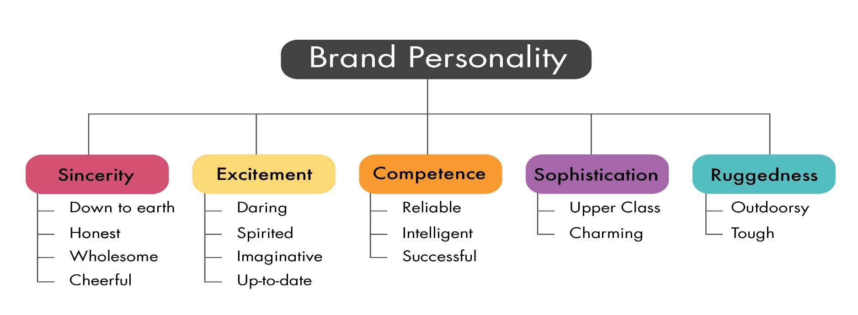
Aaker’s Brand Personality Dimensions
Aaker (1997)

Slide 17





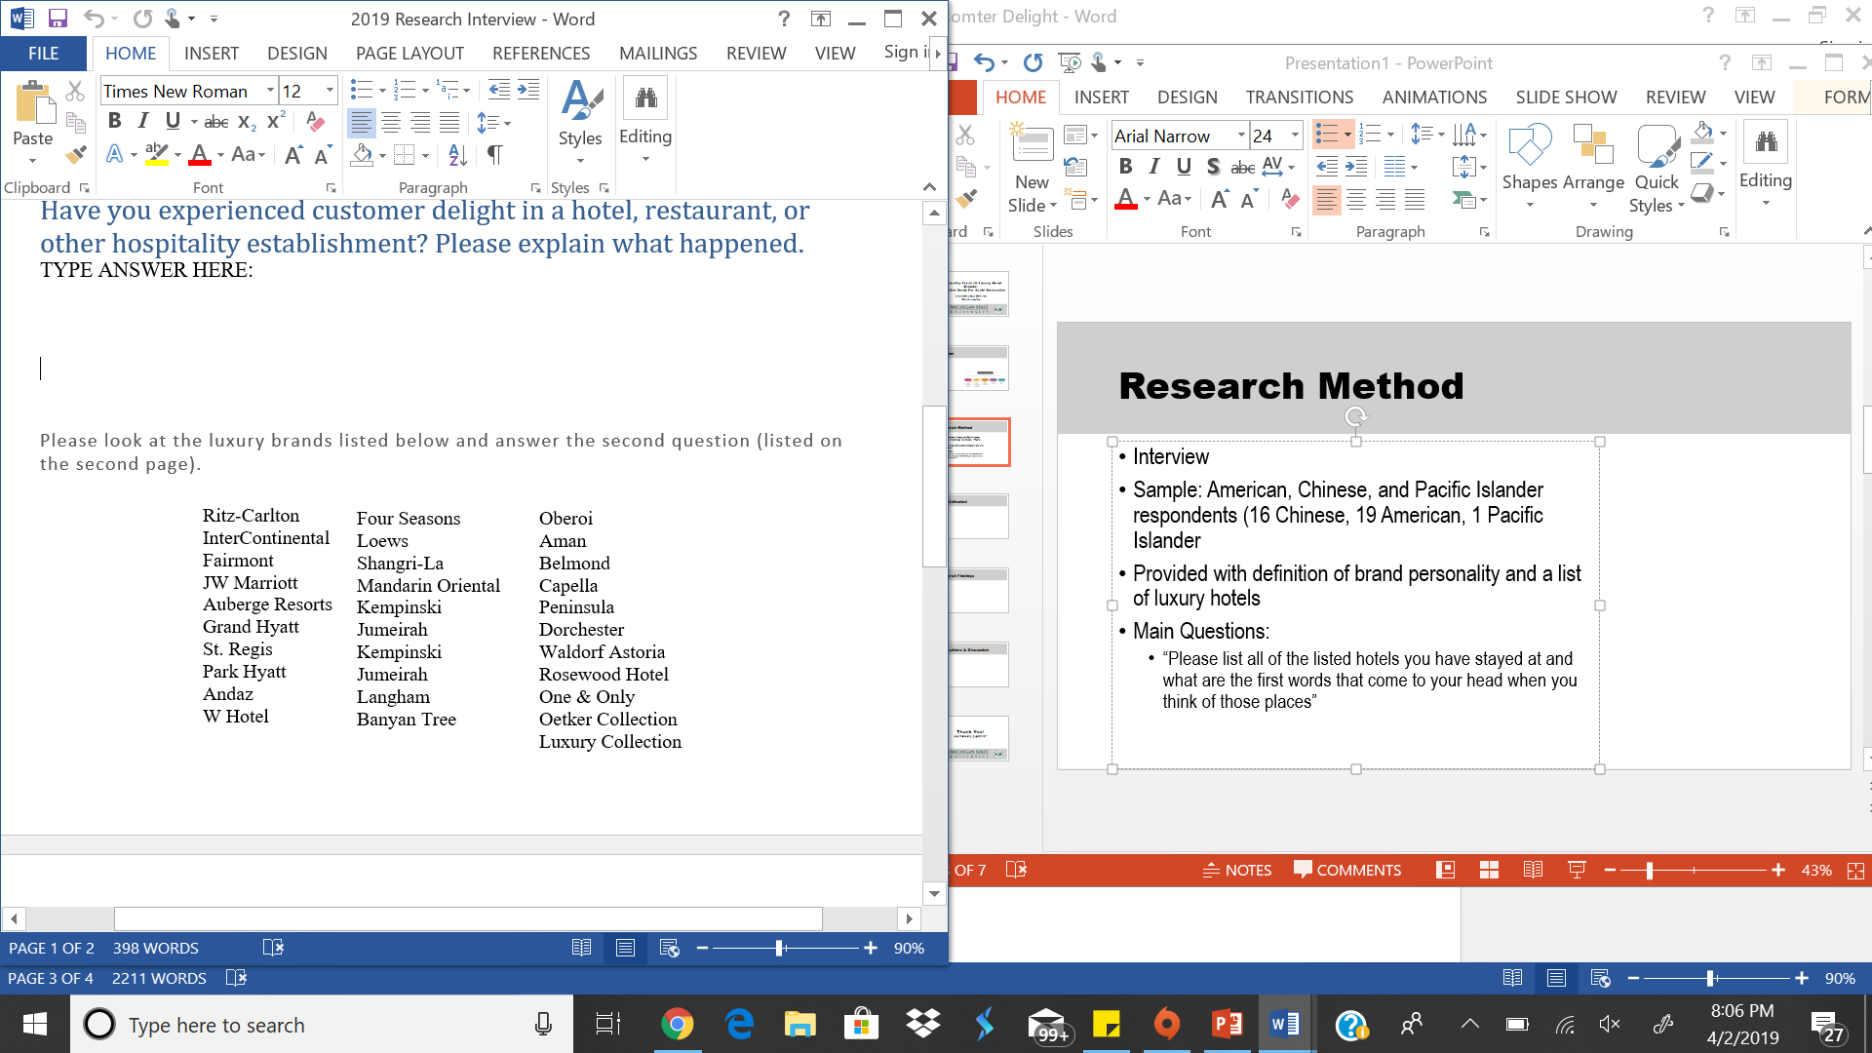
Methodology
An open-ended interview
The 30 well-known luxury hotel brands were selected based on results from Trip Advisor, Travelocity, and Forbes Magazine
A total of 36 people participated in the interview
Main Questions:
  “Please list all of the listed hotels you have stayed at or are familiar to the brands and what are the first words that come to your mind when they thought of the luxury brands.”
(List of Luxury Hotel Brand provided to Interviewees)

Slide 18

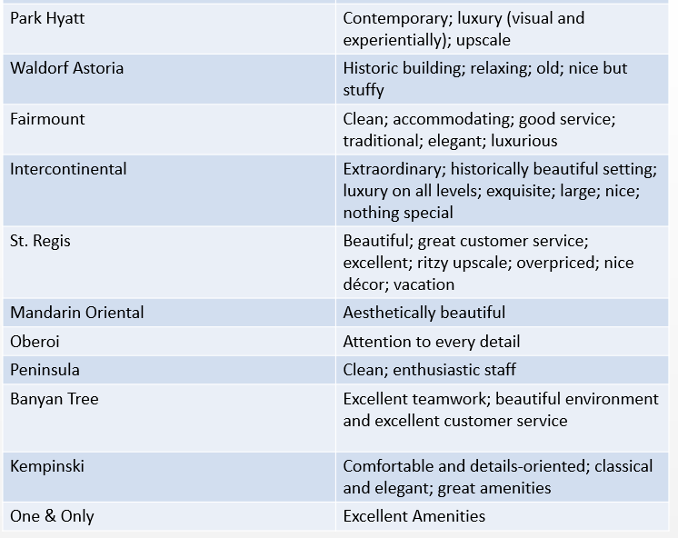
Research Findings
Hotel Name | Associated Characteristics
Four Seasons | Shopping mall; guarantee quality; Clean and minimalism design; Expensive; Comfortable; Every corner’s designs are beautiful; Great environment and has best restaurant; Professional Hospitality Talents; They can be rated as seven stars; nice; convenient; golf; impeccable service; amazingly luxurious
Shangri-La | Rich; unique; mysterious; professional and responsible staff; luxurious; kind; romantic; comfortable; relaxing; expensive; elegant; best brunch experience
JW Marriott | Popular brand; law-abiding; luxurious; great customer service; convenient location and great customer service; formal; business-focus; fancy; beautiful; great customer service; excellent; better quality; elegance; reasonably priced; artsy; modern
Loews | Music; great roof tops
Ritz-Carlton | Large; grandeur; excellent customer service; beautiful; great customer service; excellent; impersonal; classy; high-end; heavy
W Hotel | Relaxing; fashion and modern design; comfortable; exotic; fun; hip; luxurious; amazing view; grand lobby; excellent customer service; perfect location; beautiful interior; bold; variety; contemporary; modern luxury
Grand Hyatt | Best restaurant; comfortable; expensive; oversized
Park Hyatt | Contemporary; luxury (visual and experientially); upscale
Waldorf Astoria | Historic building; relaxing; old; nice but stuffy
Fairmount | Clean; accommodating; good service; traditional; elegant; luxurious
Intercontinental | Extraordinary; historically beautiful setting; luxury on all levels; exquisite; large; nice; nothing special
St. Regis | Beautiful; great customer service; excellent; ritzy upscale; overpriced; nice décor; vacation
Mandarin Oriental | Aesthetically beautiful
Oberoi | Attention to every detail
Peninsula | Clean; enthusiastic staff
Banyan Tree | Excellent teamwork; beautiful environment and excellent customer service
Kempinski | Comfortable and details-oriented; classical and elegant; great amenities
One & Only | Excellent Amenities

Slide 19
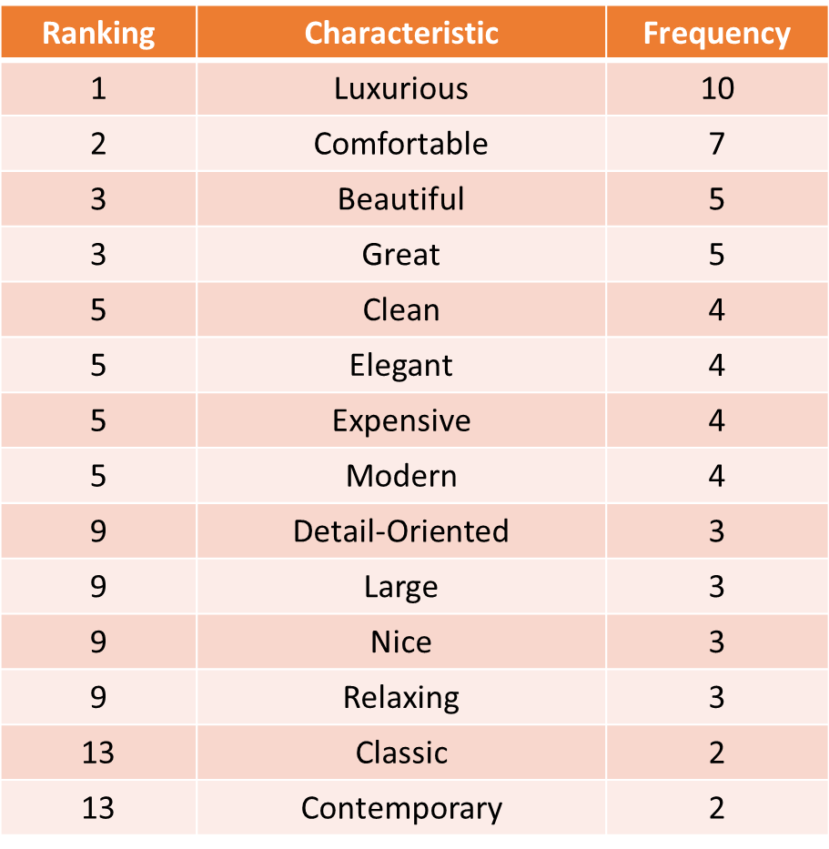
Findings

Slide 20
Brand Affect and Trust
Kim and Kim, 2004: Brand Personality relates to consumer trust and emotions that are established in a consumer’s mind.
Notes:
Brand personality is defined as “the set of human characteristics associated with a brand” (Aaker 1997, 347) and relates to consumer trust and emotions that are established in a consumer’s mind (Kim and Kim 2004). Since Aaker (1997) first introduced the concept of brand personality, a significant amount of research has been conducted in various industry settings. A strong and differentiated brand is an intangible asset that enhances a firm’s financial value and brand equity (O’Neill and Mattila, 2006). Because brands create an identity and personality with a set of promises to customers, customers are more likely to choose a specific brand that they like and that is consistent with their personalities (Heath and Scott, 1998). In the hotel industry, brand personality is proposed to be a critical driver that develops customer preference and strong relationship with one brand over another because functional characteristics of hotel products are difficult to be differentiated (Siguaw et al., 1999).

Slide 21
Study Objectives
Examine the impact of brand personality dimensions-sincerity, excitement, competence, and sophistication-on brand trust, affect, and loyalty in the luxury hotel context.
Explore the relative impact of each brand personality dimension through dominance analysis.
Considering that little research has been conducted on the role of brand personality on actual consumer behaviors in the hospitality industry, this study can contribute significant insights into the hospitality literature and practices.
Notes:
Brand personality is defined as “the set of human characteristics associated with a brand” (Aaker 1997, 347) and relates to consumer trust and emotions that are established in a consumer’s mind (Kim and Kim 2004). Since Aaker (1997) first introduced the concept of brand personality, a significant amount of research has been conducted in various industry settings. A strong and differentiated brand is an intangible asset that enhances a firm’s financial value and brand equity (O’Neill and Mattila, 2006). Because brands create an identity and personality with a set of promises to customers, customers are more likely to choose a specific brand that they like and that is consistent with their personalities (Heath and Scott, 1998). In the hotel industry, brand personality is proposed to be a critical driver that develops customer preference and strong relationship with one brand over another because functional characteristics of hotel products are difficult to be differentiated (Siguaw et al., 1999).

Slide 22
Luxury Brands Personality
Keller (2009) suggested that luxury brands make consumers feel better about themselves; i.e., consumers feel a sense of pride, accomplishment, and fulfillment in owning objects bearing the labels of luxury brands.
As an important emerging market, the study of brand-personality functions in this luxury hotel segment will be timely for hotel marketers.
In the hospitality industry, brand personality is proposed to be a critical driver that develops customer preference and strong relationship with one brand over another (Siguaw et al., 1999).
In
Notes:
However, there is little empirical research that has investigated the structure of luxury hotel brand-personality dimensions and scales.

Slide 23
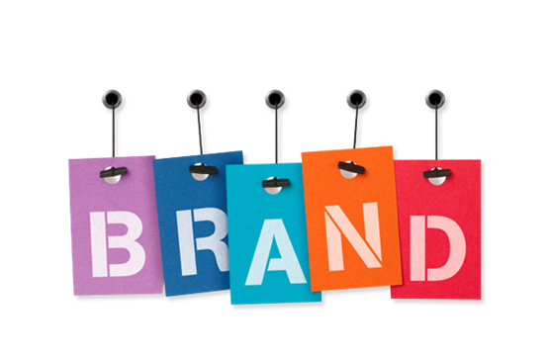

Why Brand Personality?
Strong and differentiated brands are intangible assets that enhance a firm’s financial value and brand equity (O’Neill & Mattila, 2006).
Brand personality relates to consumer trust and emotions that are established in a consumer’s mind (Kim & Kim, 2004).

